Slide 1
Informatica PowerCenter
Lesson 8: Workflow Tasks

Slide 2
Lesson Objectives
In this lesson you will learn about:
  Command Task
  Email Task
  Timer Task
  Assignment Task
  Control Task
  Event Tasks
  Decision Task
  Worklets
  Version Control Overview

Slide 3
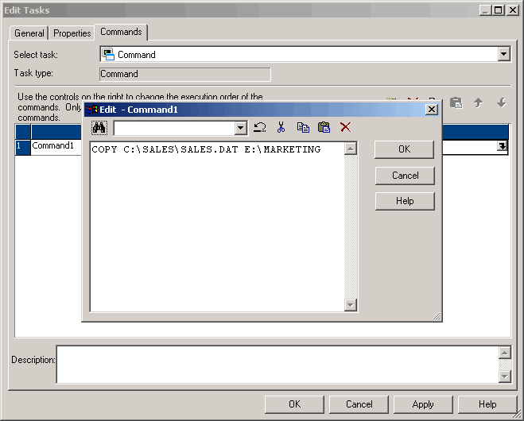
8.1. Command Task Description
A Command Task is used to specify commands to run during the Workflow
It can be used in two ways:
  Standalone Command Task
  Pre- or post-session command
It can be used to:
  Delete reject files
  Copy files
  Archive target files
Command Tasks created in the Task Developer are reusable
Figure 8.1
Notes:
The Command Task can be used in two ways:
Standalone Command Task – Command Task can be used anywhere in the Workflow or Worklet to run shell commands
Pre- and post-session shell command – Command Task can be called as the pre- or post- session shell command for a Session Task
Any valid UNIX command or shell script can be used for UNIX servers, or any valid DOS command or batch file for Windows servers.
The status of the command (success or failure) is stored in the pre-defined variable @command_Task_name.STATUS.
For example, a command Task may be used to copy a file from one directory to another. For a Windows Server the following DOS command will be used to copy a file SALES.DAT from the source directory, C:\SALES to the target directory E:\MARKETING
COPY C:\SALES\SALES.DAT E:\MARKETING
For a UNIX server, the following command will be used to perform a similar operation:
Cp sales/sales.dat /marketing
Each command runs in the same environment (UNIX or Windows) as the Integration service.

Slide 4
Demo
Configure a Command Task
Notes:
Steps to create a Command Task:
In the Workflow Designer or the Task Developer, click the Command Task icon on the Tasks toolbar.
-or-
Choose Task | Create. Select Command Task for the Task type.
Enter a name for the Command Task. Click Create. Then click Done.
Double-click the Command Task in the workspace to open the Edit Tasks dialog box.
In the Commands tab, click the Add button to add a command.
In the Name field, enter a name for the new command.
In the Command field, click the Edit button to open the Command Editor.
Enter the command which has to be performed. Enter only one command in the Command Editor.
Click OK to close the Command Editor.
Repeat steps 3-8 to add more Commands in the Task.
Click OK.

Slide 5
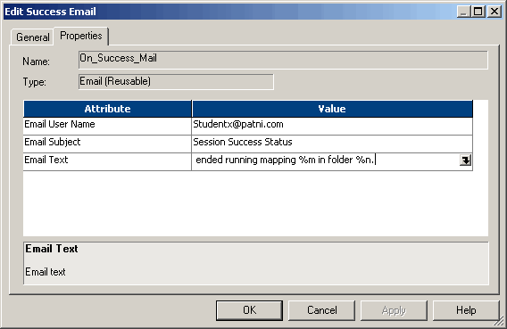
8.2. Email Task Description
An Email Task is used to send an email to designated recipients when the Integration service runs a Workflow
An Email Task can be configured for:
  Post Session, to send the success or failure status of the session
  Suspension, to send the suspension status of the Workflow
Email Tasks created in the Task Developer are reusable
Figure 8.2
Notes:
The Workflow Manager provides an Email Task to send an email during a Workflow. Re-usable Email Tasks can be created in the Task Developer for any type of email. Email Tasks created in the Workflow and Worklet Designer are non-reusable.
When a Workflow or Worklet is created the following types of email can be included:
Post-session email. The session can be configured to send an email when the session completes or fails.
Suspension email. The Workflow can be configured to send an email when the Workflow suspends.
For example, if the time taken for a session to complete has to be tracked, the session can be configured to send an email containing the time and date the session starts and completes.
An Email Task can also be used anywhere in a Workflow or Worklet. For example, it can be included in a Workflow after a Command Task that executes a shell script. The Workflow links can be configured for the Integration service to send an email if the Command Task fails.

Slide 6
8.2. Email Task
Email Variables
Email Variable | Description
%a<> | Name of file attached
%g | Session log file attached
%n | Folder name
%m | Mapping name
%d | Repository name
%t | Target table details
%s | Session name
%e | Session status
%b | Session start time
%c | Session completion time
%i | Session elapsed time
%l | Total rows loaded
%r | Total rows rejected
Notes:
Email variables and format tags can be used in an email message for post-session emails.
Using email variables, important session information, such as:
Number of rows loaded
Session completion time
Read and write statistics, etc.
Can be included in the email. The session log or other relevant files can also be attached to the email. Format tags for a tab (\t) and newline(\n) can be used in the body of the message to make the message easier to read.

Slide 7
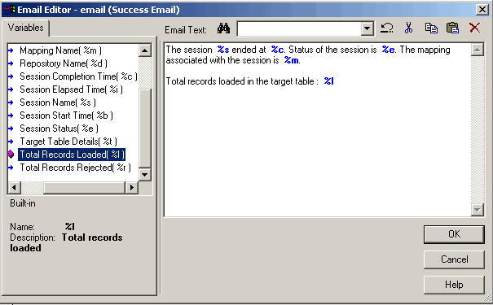
8.2. Email Task
Sample Email Text
Figure 8.3
Notes:
In the above figure you see a sample email text, which gives the following details
Name of the session and mapping
Session completion time
Number of records loaded

Slide 8
Demo
Configure an Email Task
Notes:
Steps to create an Email Task in the Task Developer:
In the Task Developer, choose Tasks | Create.
Select an Email Task and enter a name for the Task. Click Create.
Click Done.
Double-click the Email Task in the workspace. The Edit Tasks dialog box appears.
Click Rename to enter a name for the Task.
Optionally enter a description for the Task in the Description field.
Click the Properties tab.
Enter the fully qualified email address of the mail recipient in the Email User Name field.
Enter the subject of the email in the Email Subject field. Or, leave this field blank.
Click the Open button in the Email Text field to open the Email Editor.
Enter the text of the email message in the Email Editor.
When the Email Task is used for post-session email, incorporate variables and format tags in the message. Leave the Email Text field blank.
Click OK twice to save changes.

Slide 9

8.3. Timer Task Description
A Timer Task is used to specify the period of time to wait before the Integration service executes the next Task in a Workflow
There are two types of settings in the timer
  Absolute time
  Relative time
Figure 8.4
Notes:
When a Timer Task is used in a Workflow, the next Task in the Workflow (after the timer Task) can be started at an exact time and date. After the start time of another Task, a wait period can be set in the Workflow, or Worklet before starting the next Task.
The Timer Task has two types of settings:
Absolute time - The exact time that the Integration service starts executing the next Task in the Workflow is specified
Relative time - The Integration service will wait for a specified period of time after the Timer Task, the parent Workflow, or the top-level Workflow starts
For example, if there are two sessions in a Workflow and the second session should start 1 minute after the first session completes; A Timer Task can be used after the first session.

Slide 10
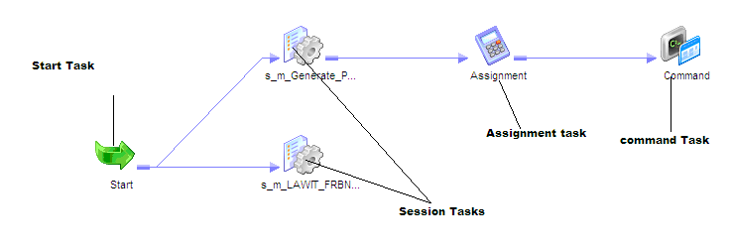
Assignment Task
  Assigns a value to a Workflow variable
  Variables are defined in the Workflow object

Slide 11
Control Task
  Used to stop, abort, or fail the top-level workflow or the parent workflow based on an input link condition.
  A parent workflow or worklet is the workflow or worklet that contains the Control task.

Slide 12
8.4. Event Tasks Description
An Event is defined in a Workflow to specify the sequence of Task execution
The event is triggered based on the completion of the sequence of Tasks
To use events in the Workflow the Tasks are:
  Event-Raise Task
  Event-Wait Task
Events that can be defined are:
  Pre-defined event
  User-defined event
Notes:
To coordinate the execution of the Workflow, the following types of events are specified for the Event-Wait and Event-Raise Tasks:
Pre-defined event - A pre-defined event is a file-watch event. For pre-defined events, an Event-Wait Task is used to instruct the Integration service to wait for the specified indicator file to appear before continuing with the rest of the Workflow. When the Integration service locates the indicator file, it starts the next Task in the Workflow
User-defined event - A user-defined event is a sequence of Tasks in the Workflow. An Event-Raise Task is used to specify the location of the user-defined event in the Workflow. A user-defined event is sequence of Tasks in the branch from the Start Task leading to the Event-Raise Task
When all the Tasks in the branch from the Start Task to the Event-Raise Task complete, the Event-Raise Task triggers the event. The Event-Wait Task waits for the Event-Raise Task to trigger the event before continuing with the rest of the Tasks in its branch.

Slide 13
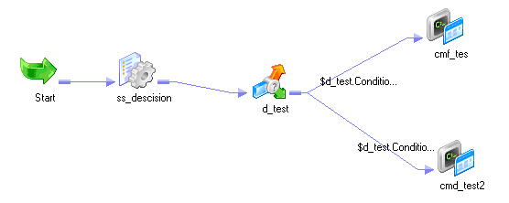
8.5. Decision Task Description
A Decision Task is used to enter a condition that determines the execution of a Workflow
A pre-defined variable, $Decision_Task_name.Condition represents the result of the decision condition
The Integration service evaluates the condition in the Decision Task and sets the pre-defined condition variable to True (1) or False (0).
Figure 8.5
Notes:
One decision condition can be specified per Decision Task. After the Integration service evaluates the Decision Task, the pre-defined condition variable can be used in other expressions in the Workflow to develop the Workflow.
You can use the Decision task instead of multiple link conditions in a workflow. Instead of specifying multiple link conditions, use the pre-defined Condition variable in a Decision task to simplify link conditions.
The Decision Task simplifies the Workflow. If a condition is not specified in the Decision Task, the Integration service evaluates the Decision Task to True.

Slide 14
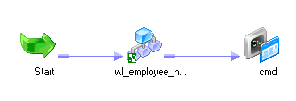
8.6. Worklets Description
A Worklet is a set of reusable Workflow logic
The Worklet Designer is used to create and edit Worklets
It can contain any Task available in the Workflow Manager
Worklets can be run inside a Workflow
The Workflow that contains the Worklet is called the parent Workflow
A Worklet can be nested in another Worklet
Figure 8.6
Notes:
A Worklet is an object that represents a set of Tasks. When the Integration service executes a Worklet, it expands the Worklet. The Integration service then runs the Worklet as it would run any other Workflow, executing Tasks and evaluating links in the Worklet.
The Worklet does not contain any scheduling or server information. To execute a Worklet, it has to be included in a Workflow. The Workflow Manager does not provide a parameter file or log file for Worklets. The Integration service writes information about Worklet execution in the Workflow log.

Slide 15
8.8. Worklets Version Control Overview
Version Control is PAID tool in Informatica
Version Control is used to
  Prevent multiple users working on same code
  Stores older versions of code which can be retrieved if required.
  Can compare the changes in different version of code
How to do version control ?
  Code version control is gets operated by check-in and check-out options of informatica.
  Check out: Check out the object if you want to modify code. Informatica will place write-intent lock to it. No other user can edit the object after check-out.
  Check in: Save the object after editing. After check-in your changes will be visible to others. Now object can be edited by other user. write-intent lock will be released.
  Undo Check-out: This option will rollback all the changes. Informatica will restore latest checked-in version to repository.
Other Version Control Tools
  SVN
  TFS

Slide 16
Demo
Creating a Worklet
Notes:
Steps to create a Worklet:
In the Worklet Designer, choose Worklets | Create. The Create Worklets dialog box appears.
Enter a name for the Worklet.
Click OK.
The Worklet Designer creates a Start Task in the Worklet.
Now, drag the required Tasks in the designer space as per the Worklet logic.

Slide 17
Summary
After completing this lesson you now:
  Command Task
  Email Task
  Assignment Task
  Control Task
  Timer Task
  Decision Task
  Event Tasks
  Worklet
  Version control

Slide 18
Review Question
Question 1: In a Workflow, an email is used to send ____________ information
Question 2: There are two kinds of events ________ and ________
Question 3: A ________ Task is used to enter a condition that determines the execution of a Workflow
Question 4: Worklets can be run independently.
  True/False

